Slide 1

KALERWE
S.D.A Hymnal 341
5 ~ Verses
63.
Bwendowooza Omusalaba…
~
When I survey The wondrous Cross…

Slide 2

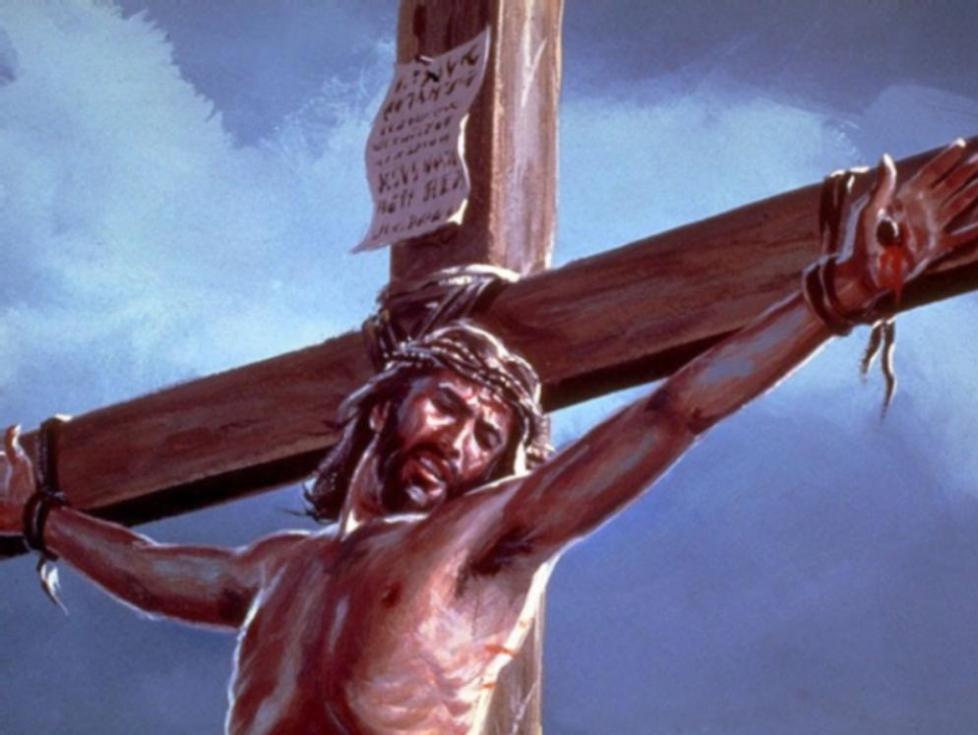
1 of 5 verses
Bwendowooza omusalaba Mukama ggwe yaffirako
(O)bugagga bwonna obw’ensi Mbulaba nga tebuliimu

Slide 3
2 of 5 verses
Bwe ndaba amazzi n’omusaayi Ebyava mu mbiriizi ze Nentegeera okusasira N’okwagala kwe bwe kuli

Slide 4
3 of 5 verses
Yesu Mukama onkuume, Neme okwenyunirizanga Kino kyokka kinsanyuse Wanjagala n’onfiirira

Slide 5
4 of 5 verses
Singa mbadde n’ensi zonna Nenziwaayo Yesu Gy’oli;
Zonna tezandisasudde
(E)bbanja lyange eryenkan(a) awo

Slide 6
5 of 5 verses
Naye ky’oyagala leero ,
Era kye ndeese nze eri ggwe
kwe kwagala kwange kwonna Nkuweereze nkusanyuse

